Slide 1
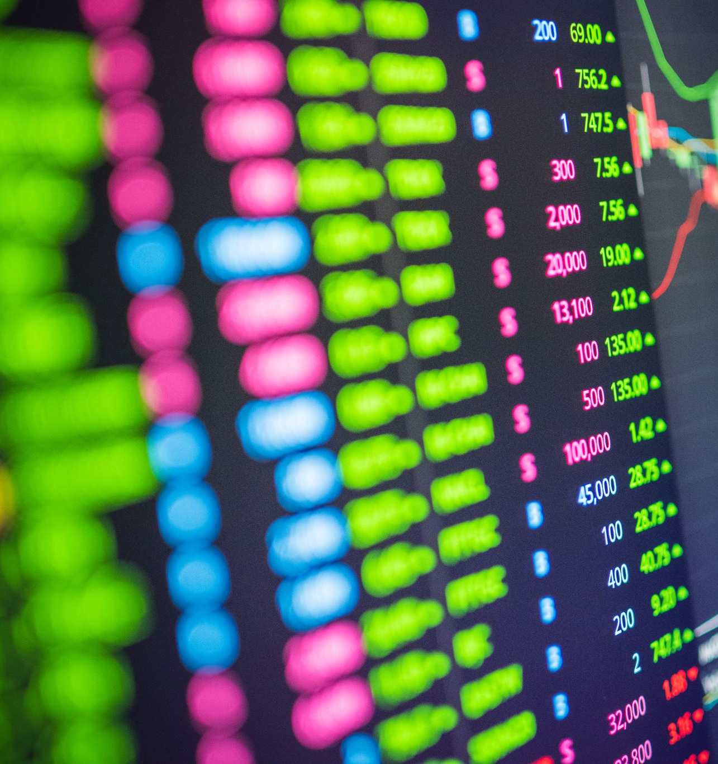
Machine Learning Model for Stock Value Prediction
To:
Dr. Surendar Kumar Shukla
BY:
-Gauri Gupta
-D
-2018809

Slide 2
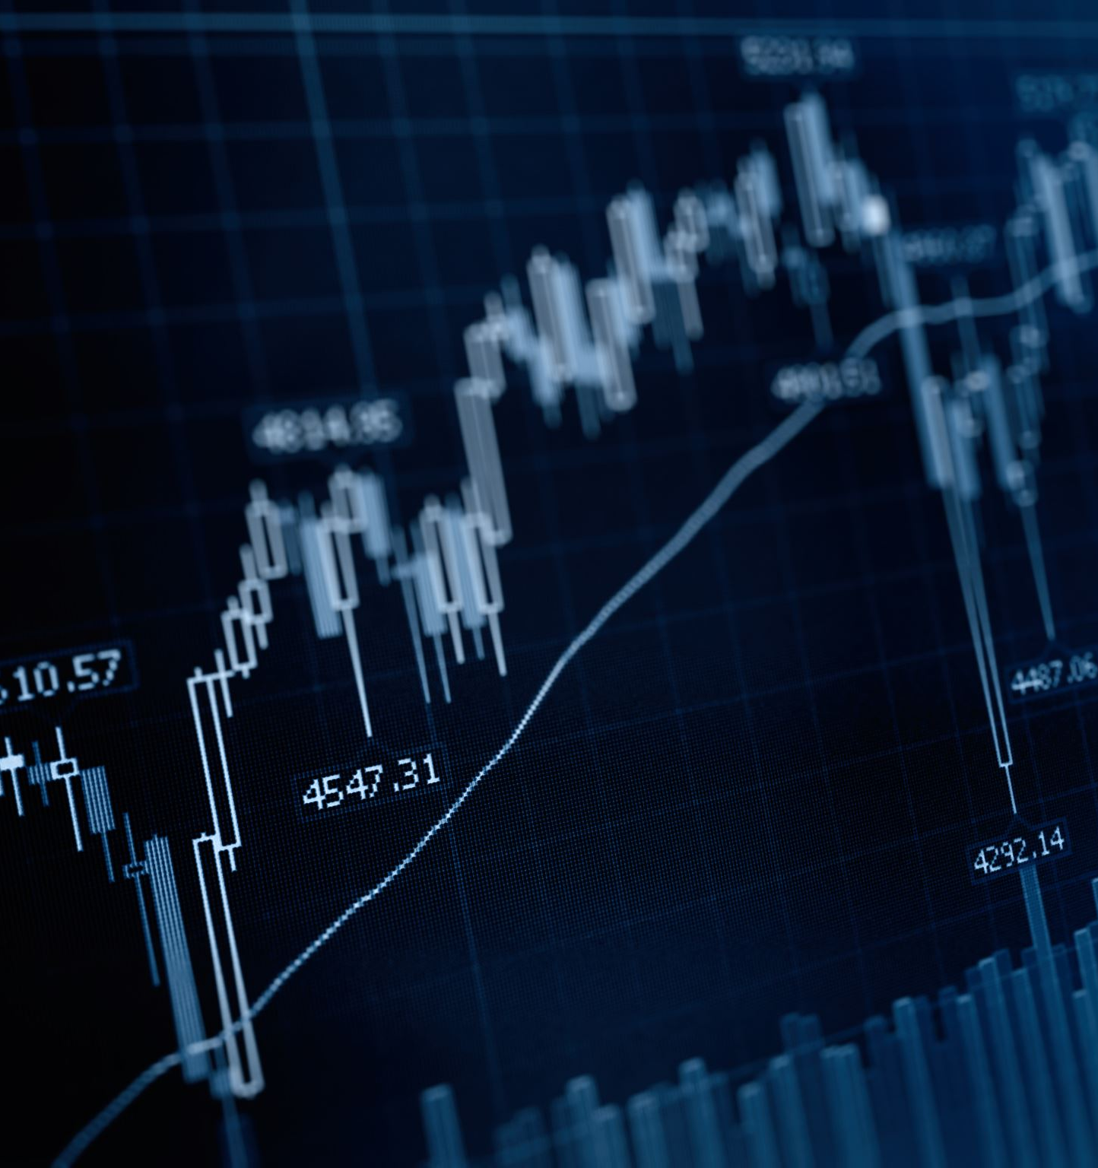
Introduction
What is Stock?
Capital is the most important part of starting and growing a business and generally a business raise capital through loans, diluting equity to big investors or issuing shares of some percentage part of the company. Shares are nothing but a small part in a company. Shares are also known as stock. Stock markets are always an attractive investment way to grow capital. Some well-known king of stock market were/are Warren Buffett, Rakesh Jhunjhunwala, Harshad Mehta and many more.

Slide 3

Machine Learning
Machine learning is a method of teaching computers to learn from data, without being explicitly programmed. It uses algorithms that can identify patterns in data and make predictions or decisions without human intervention. Machine learning can be divided into three main categories: supervised learning, unsupervised learning, and reinforcement learning.

Slide 4
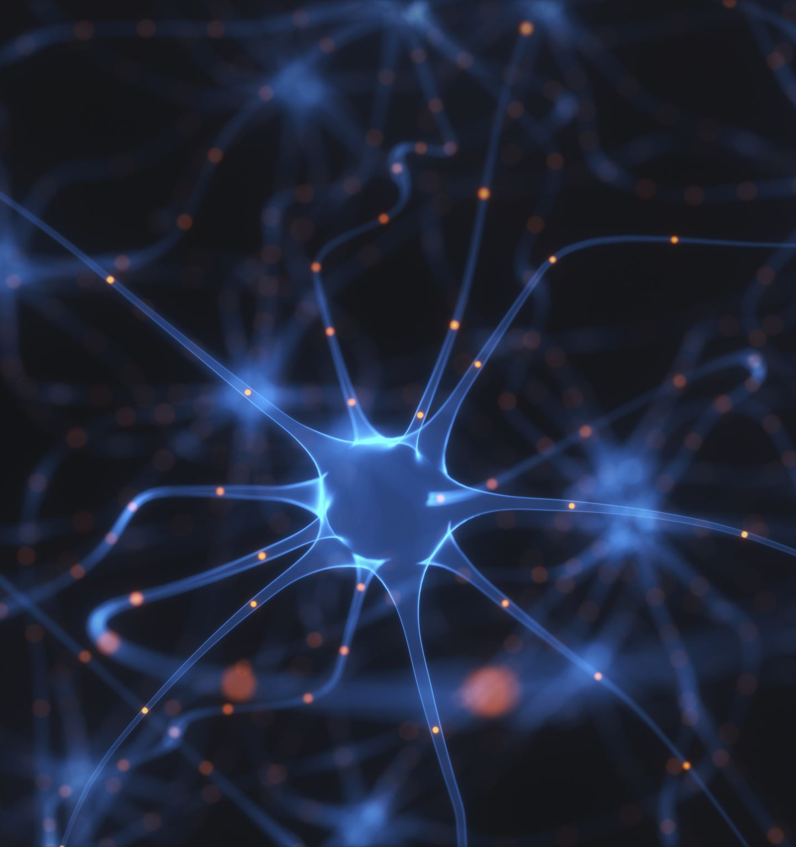
Tools Included
RNN ( recurrent neural network )
A recurrent neural network (RNN) is a class of artificial neural network where connections between nodes can create a cycle, allowing output from some nodes to affect subsequent input to the same nodes. This allows it to exhibit temporal dynamic behavior.

Slide 5
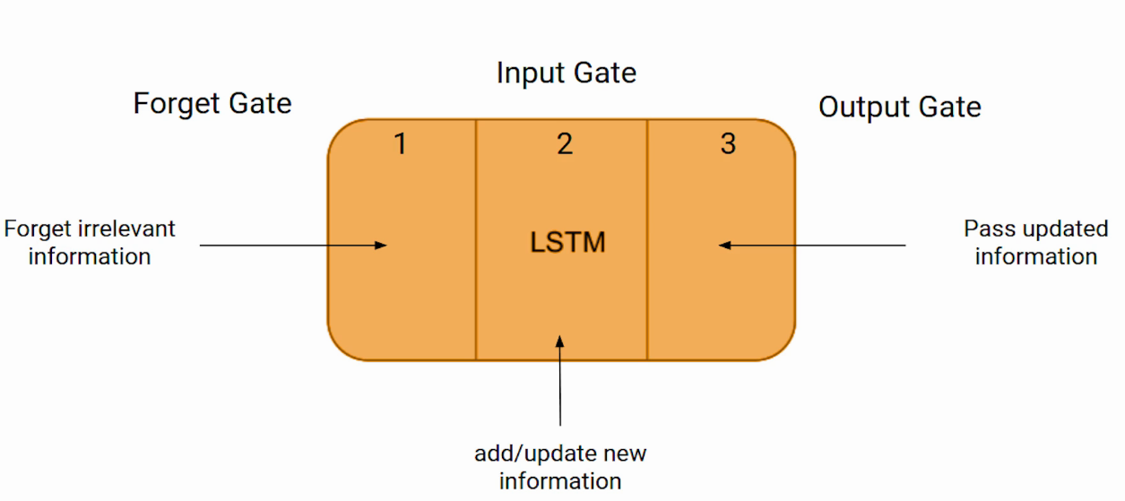
LSTM(Long Short Term Memory)
LSTM — Long Short Term Memory is an improvement over Recurrent Neural Network to address RNN’s failure to learn in the presence of past observations greater than 5–10 discrete time steps between relevant input events and target signals (vanishing/exploding gradient issue). LSTM does so by introducing a memory unit called “cell state”.

Slide 6
What My Project is Doing.
My project took a csv file which have stock value information of Netflix company of last 5 years.
We checked some basic information such as correlation and information of data.
We then converted our data to scale from 0 to 1 .This helps to make the data more responsive to machine learning models, which often perform better when the input data is in a consistent scale.
Now we divided our data in two parts such that one is training set which was 75% of total data and other was testing set which was 25% of our data.

Slide 7
Then we cretaed a deep learning model using the Long Short-Term Memory (LSTM) algorithm from the TensorFlow library. The LSTM algorithm is a type of Recurrent Neural Network (RNN) that is able to retain information for longer periods of time.
For training our data we set epoch to 10 that mean our model will be trained 10 times which help us in getting more accurate data.
After training and testing our model we will predict stock prize by passing through the trained LSTM model.

Slide 8
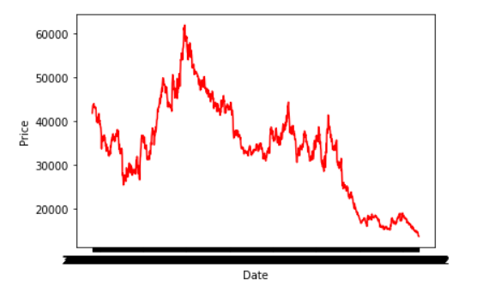
Results This is original graph of ‘CLOSE’ in projectDataSheet.csv

Slide 9
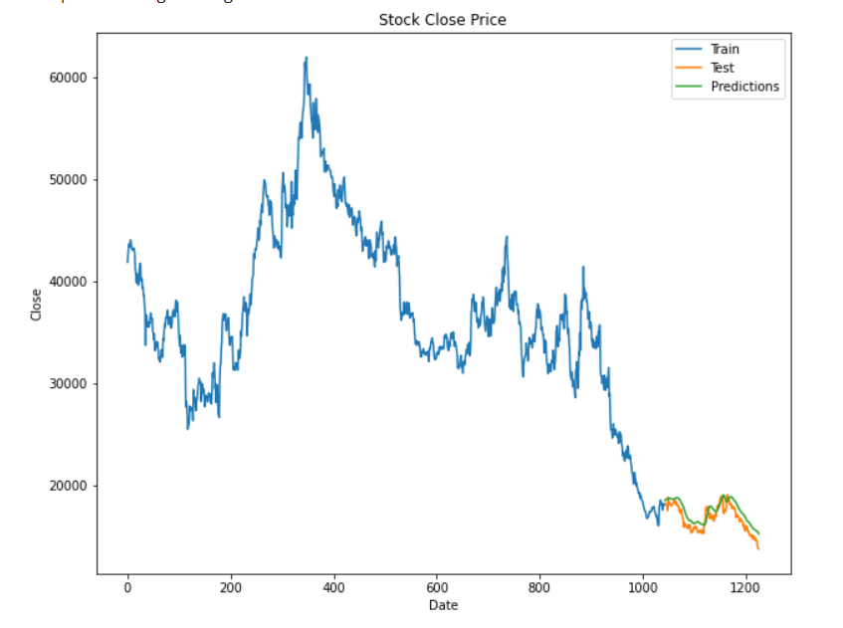
On combining trainset and test set we get the above graph which is very similar to original graph

Slide 10
Conclusion
Machine learning / AI proved that it is soon going to be the future of the world. Individuals have already used or are implementing and improving the Machine learning algorithms to give betterment predictions of the stock prices. Although prediction of stock price varies on multiple (micro and macro) factors a rough estimation can be made with the above-used techniques. But still Machine Learning has one of the brightest future in the prediction world.

Slide 11
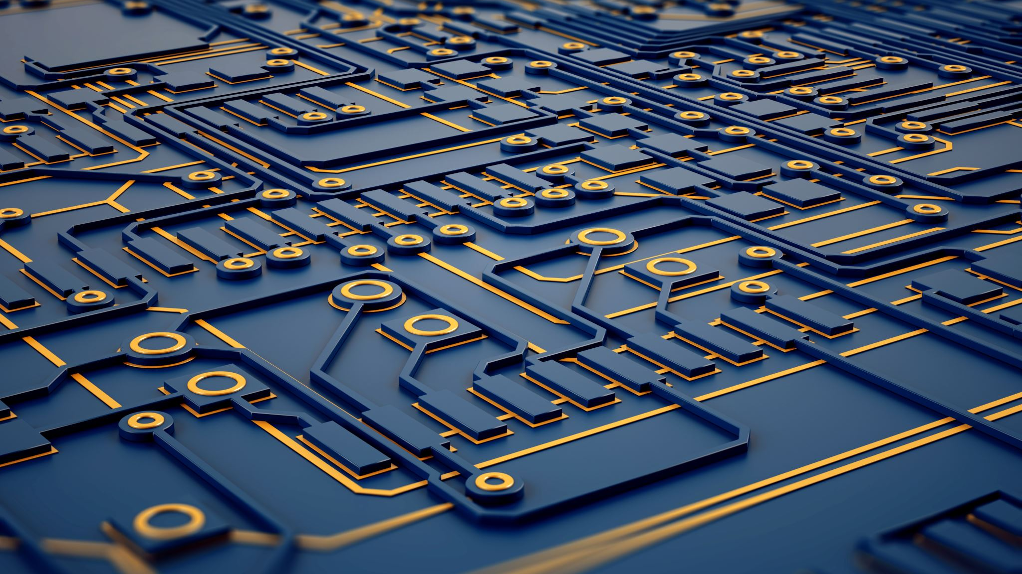
Thank-You
Thank You

